Slide 1

CREDIT EDA ASSIGNMENT
risk analytics in banking and financial services

Slide 2
Business understanding
A bank is a type of financial institution that accepts public deposits and lends money to both individuals and corporations. it can be challenging to grant loans to individuals, due to their weak or nonexistent credit histories which may increase defaults.
When a loan application is received, the business must evaluate whether to approve the loan based on the applicant's profile. The bank's choice is subject to two different kinds of risks:
If the borrower is likely to repay the loan, refusing to grant it results in the company losing business.
Otherwise if he is defaulter, then approving the loan may result in a loss of revenue for the business.
To examine the patterns found in the data, you must use EDA. By doing this, it will be ensured that only those applicants who can repay the loan would be accepted.

Slide 3
Business Objective
This case study tries to find trends that show whether a client is having trouble making their payments, which may be used to decide whether to grant the loan, reduce its size, charge riskier applicants a higher interest rate, etc. By doing this, it will be ensured that only borrowers who can repay the loan will be accepted.
The objective of this case study is to identify such applications using EDA. You have to use EDA to analyze the patterns present in the data. This will ensure that the applicants capable of repaying the loan are not rejected.
In other words, the organization seeks to understand the characteristics that are reliable predictors of loan default, also known as the driving factors (or driver variables) behind loan default. This information can be used by the business in portfolio management and risk analysis.

Slide 4
Approach
Imported required libraries for data cleansing and visualization.
With help of pandas we read two datasets which will required for EDA
We've segmented the features into manageable chunks and examined them section by segment using a more compact data frame that only included relevant categories.
Data Cleaning, Missing Data Handling, Handling Outliers, Type casting are done segment-wise.
Wherever required we have created new feature.
Plots and percentage wise Defaulter calculation are done segment-wise as well.
Merged two dataset and by using relevant categorical or numerical data we have performed univariate and bivariate analysis, to derive insights.

Slide 5
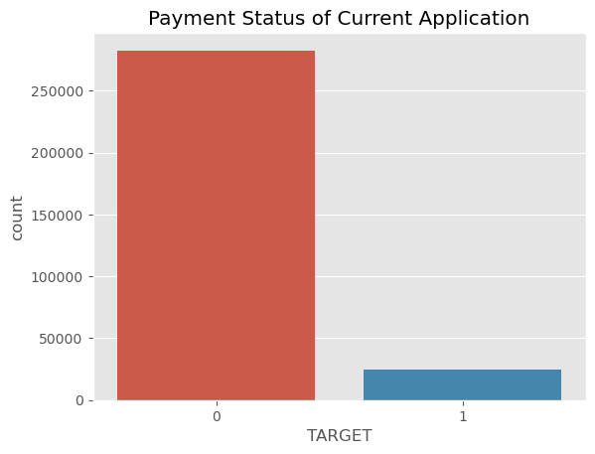
Target variable
92% of people did not default compared to 8% of the people in the dataset.
Percentage of defaulters: 8.072 %
High imbalance between the defaulters and non-defaulters.
Data Imbalance Ratio:- 8 : 92

Slide 6
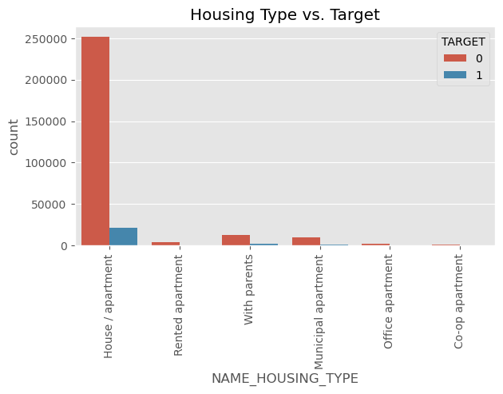
Housing type vs Target
Mostly of the applicants live in House/Apartment
Applicants living with their parents or in rented apartment have higher rate of default.

Slide 7
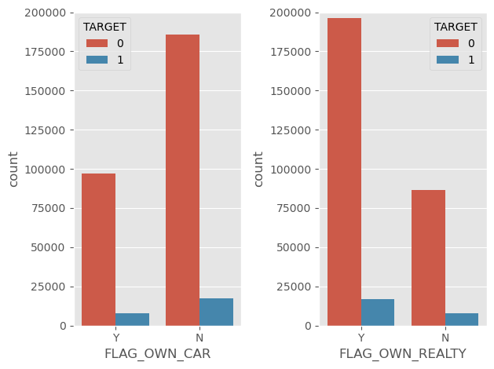
Default Ness vs assets owned
Most of the applicants do not own cars
People not owning reality and car and have a slightly higher default rate than the people who own reality and car

Slide 8
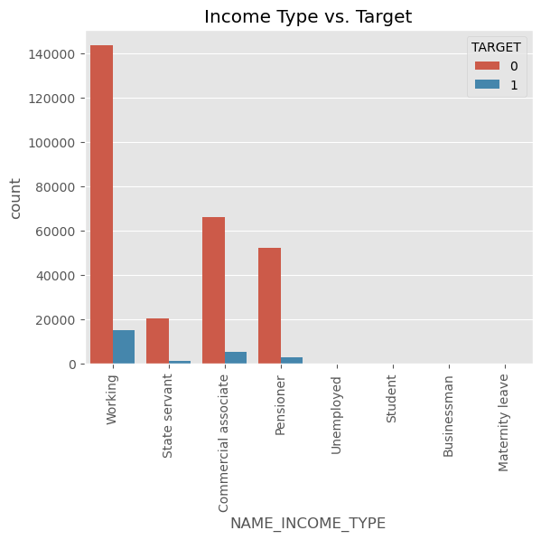
Education and occupation
Most of the applicants are working.
Applicants on Maternity Leave and Unemployed has highest percentage of Defaulter
Low skilled laboures have very high rate of defaulters in comparison to other occupations

Slide 9
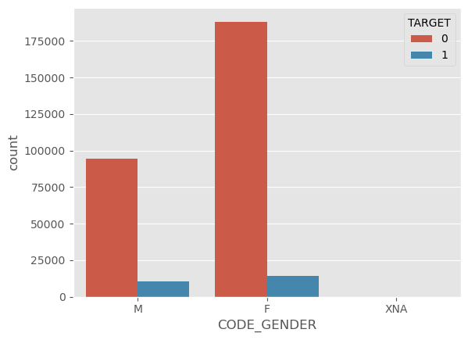
Gender info
Female applicants are more than male applicants
Defaulter percentage is higher for male applicants

Slide 10
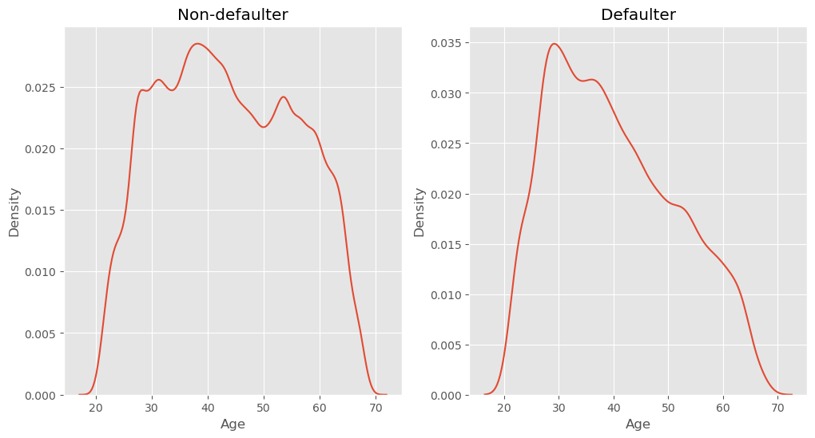
Age info
People of age 30 have higher default rate
Default cases are less for applicants more than 40 years old.

Slide 11
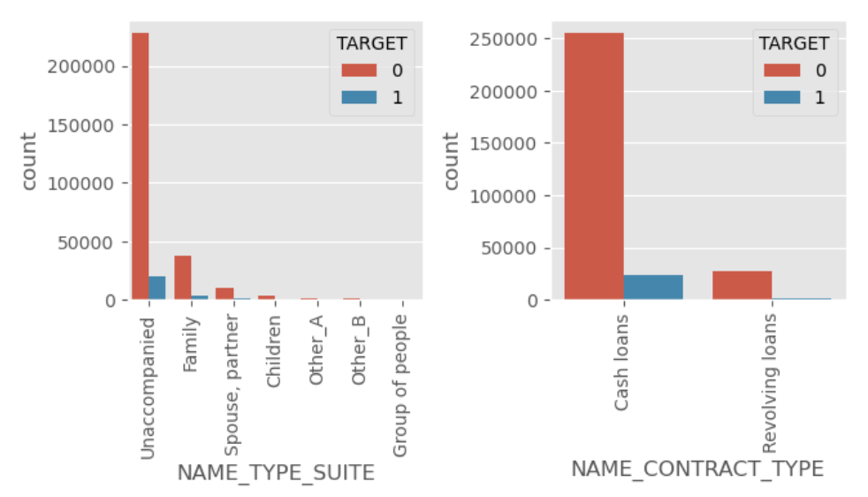
Loan type and applicant company
Most of the applicants are unaccompanied while applying for loan
Number Cash loans is quite higher than Revolving Loans

Slide 12
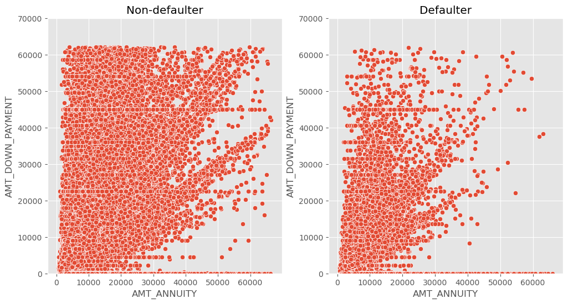
Annuity amount vs down payment
Number of defaulters are less for larger amount of annuity of previous application.
For higher down payment, defaulter cases are less.

Slide 13
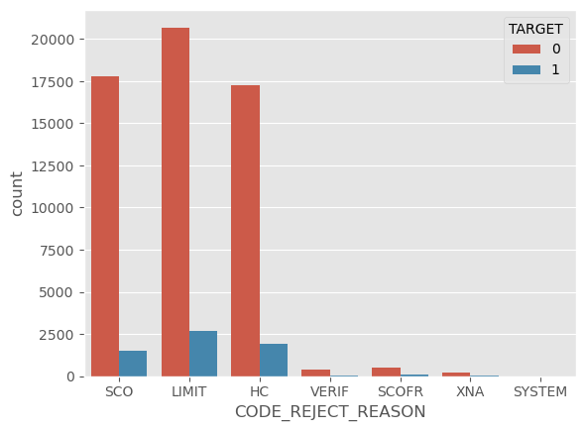
Application reject reason
'SCO', 'LIMIT' and 'HC' are the most common reason of rejection.

Slide 14
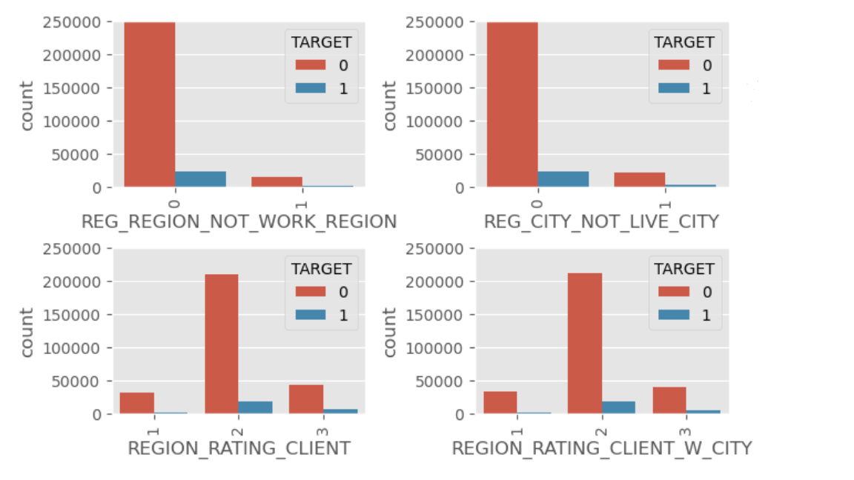
Region relation with target
Defaulter rate is highest when REG_REGION_NOT_WORK_REGION=0
i.e. permanent address and working address is same
Highest Applicants have Region rating of 2

Slide 15
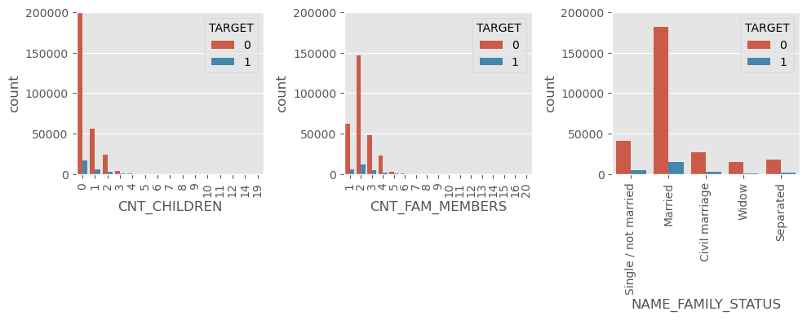
Family info
Default rate is highest for Civil Marriage and Single applicants
Applicants with relatively more number of children (and/or) family members have higher default percentage.
In some cases where count children/family members is high and the default rate is very high or very low. This cases can’t be concluded as large family applicants are very low.

Slide 16
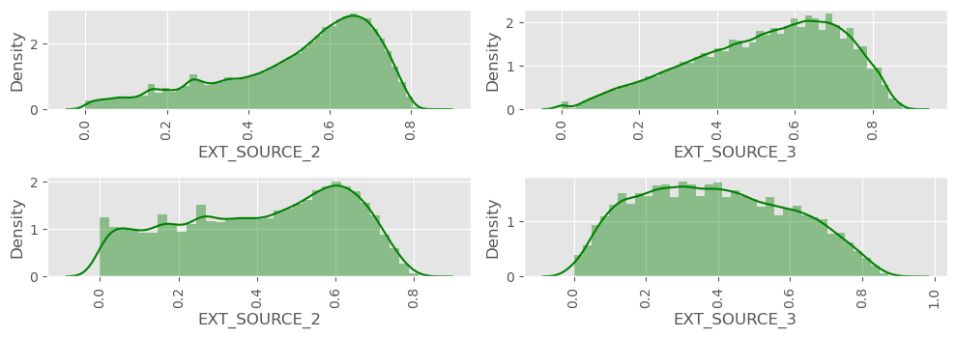
Normalized score from ext. source
Non Default
Default
'EXT_SOURCE_3' have very different distribution for defaulters and non-defaulters.
'EXT_SOURCE_2' has even distribution for defaulters and non-defaulters.

Slide 17
Conclusion
Applicants living with their parents or in rented apartment have higher rate of default.
Banks should focus on 'Students' ,'Pensioner' for successful repayments.
Banks should focus less on income type ‘Working’ as they are having most number of unsuccessful payments.
Loan Purpose on 'Repair' having highest number of unsuccessful repayments.
'Females' are more in number for applying loans.
Defaulter rate is highest when permanent address and working address is same.
Most of the people did not request insurance during previous loan application.
'SCO', 'LIMIT' and 'HC' are the most common reason of rejection.
The applicants whose previous loans were approved are more likely to pay current loan in time, than whose previous loans were rejected.
7% of the previously approved loan applicants that defaulted in current loan.
90 % of the previously refused loan applicants that were able to pay current loan.
For "Cards" defaulter percentage is highest (17%).
15% loan applicant defaulted for AP+ (Cash Loan).
Highest percentage (17%) of default cases is for 'Card Street'.
'CNT_FAM_MEMBERS', 'CNT_CHILDREN','NAME_INCOME_TYPE', 'OCCUPATION_TYPE',CODE_GENDER and 'EXT_SOURCE_3' are some of the important driving factors.

